Slide 1
Additional Techniques
Angular services and DI
Calling REST services
Demo app: AngularDev/Demos/Annex/DemoApp
To install: npm install
To run: ng serve

Slide 2
Section 1: Angular Services and DI
Overview
Dependency injection
Services and DI example
Generating a service
Implementing the service
Injecting the service
Singleton service instance

Slide 3
Overview
Don't put this kind of code in your components:
Calling REST services
Interacting with Web Sockets
Accessing state in local storage
Etc.
Instead:
Put this functionality in reusable service classes
Inject services into components, as needed
3

Slide 4
Dependency Injection
Angular supports constructor dependency injection
In your component constructor, define the services you want to be injected as parameters
Angular will inject suitable objects
How does dependency injection work in Angular?
By default, the root module provides (creates) services
Angular injects services into component constructors
4

Slide 5
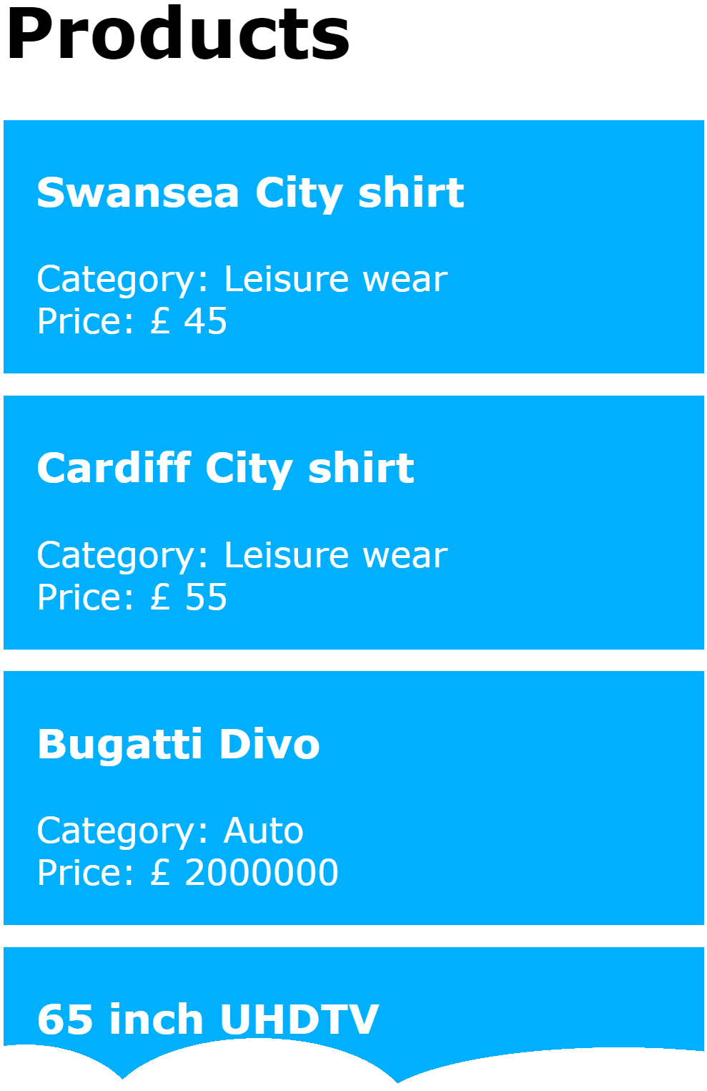
Services and DI Example
Let's see an example of services and DI
In the demo app, click the Services and DI link
ProductListComponent
ProductItemComponent
5

Slide 6
Generating a Service
We've put the responsibility for "getting products" into the ProductService class
We used Angular CLI to generate the ProductService class as follows:
ng g service product
6

Slide 7
Implementing the Service
Here's our implementation of ProductService
Note the providedIn property in @Injectable()
Specifies the service will be provided by 'root', i.e. the root module in the application
import { Injectable } from '@angular/core';
import { Product } from './product'
@Injectable({
providedIn: 'root'
})
export class ProductService {
getProducts(): Array<Product> {
var products: Array<Product> = […];
return products;
}
}
product.service.ts
7

Slide 8
Injecting the Service
You can inject service(s) into a component constructor as follows:
import { ProductService } from '../product.service'
…
@Component(…)
export class ProductListComponent {
products: Array<Product>;
constructor(productService: ProductService) {
this.products = productService.getProducts();
}
}
product-list.component.ts
8

Slide 9
Singleton Service Instances
Recall the service class is decorated as follows:
This means the service object is provided (created) by the root module
The service object is created as a singleton
The same instance will be injected into all components
Singleton is common for "infrastructure" services
@Injectable({
providedIn: 'root'
})
export class ProductService {…}
9

Slide 10
Section 2: Calling REST Services
Overview
REST service example
Pinging the REST service
Example Angular REST client
Adding support for REST clients
Calling a REST service
Consuming the REST result
Displaying the REST result

Slide 11
Overview
REST services are resource-centric services
Endpoints (URIs) represent resources
Endpoints are accessible via standard HTTP(S)
Endpoints can be represented in a variety of formats, e.g. JSON, XML, plain text, etc.
Rest services play a vital role in Angular applications
SPAs invoke REST services to get/update state
Use JSON data (or maybe XML)
11

Slide 12
REST Service Example
We've implemented a simple REST service
Returns product data
The REST service is a Node.js app, run as follows:
Open a Command Prompt window in the Server folder
Run the following commands:
npm install
npm start
12

Slide 13
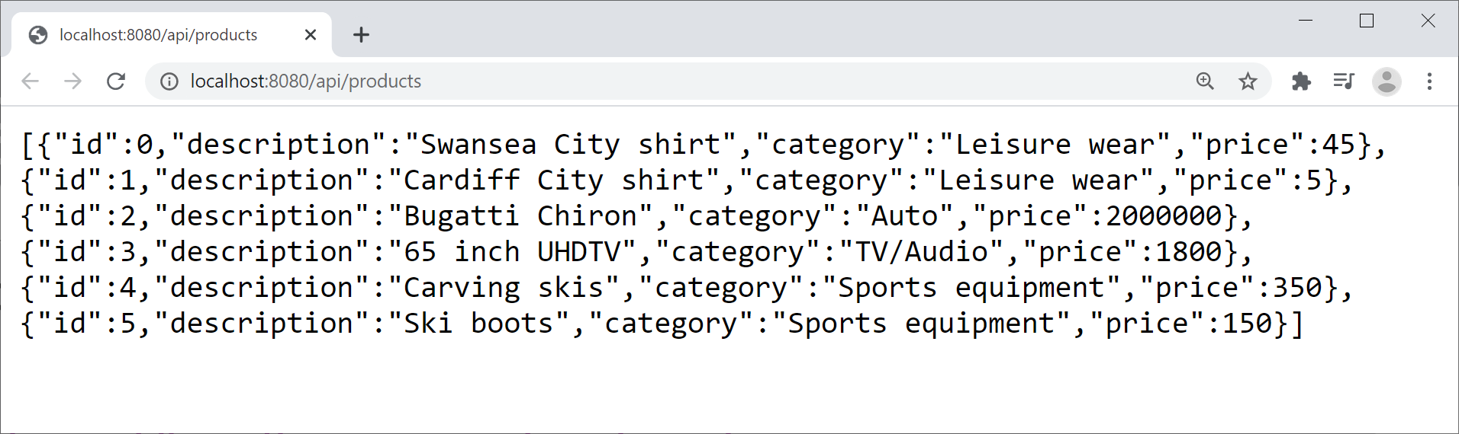
Pinging the REST Service
To ping the REST service, open a browser window and enter the following URL:
http://localhost:8080/api/products
13

Slide 14
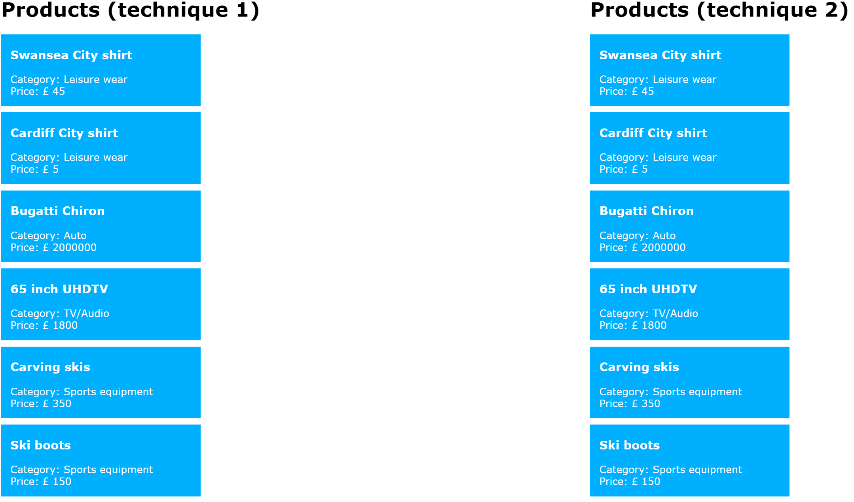
Example Angular REST Client
Let's see an example of an Angular REST client
In the demo app, click the Angular REST client link
14

Slide 15
Adding Support for REST Clients
If you want your Angular app to call a REST service, you must configure your app as follows:
This causes Angular to provide an HttpClient object, which you can then inject into your services
import { ApplicationConfig } from '@angular/core';
import { provideRouter } from '@angular/router';
import { routes } from './app.routes';
import { provideHttpClient } from '@angular/common/http';
export const appConfig: ApplicationConfig = {
providers: [
provideRouter(routes),
provideHttpClient()
]
};
app.config.ts
15

Slide 16
Calling a REST Service (1 of 2)
To call a REST service from Angular:
Inject the aforementioned HttpClient object
Call get(), put(), post(), delete()
For full details, see:
https://angular.io/api/common/http/HttpClient
16

Slide 17
Calling a REST Service (2 of 2)
We've defined an Angular service class to encapsulate calls to the "get products" REST endpoint
The call is asynchronous, returns an Observable<T>
import { HttpClient } from '@angular/common/http';
import { Observable } from 'rxjs';
…
@Injectable({providedIn: 'root'})
export class ProductViaRestService {
private baseUrl = 'http://localhost:8080/api/products';
constructor(private http: HttpClient) {}
getProducts(): Observable<Array<Product>> {
return this.http.get(this.baseUrl) as Observable<Array<Product>>;
}
}
product-via-rest.service.ts
17

Slide 18
Consuming the REST Result
We consume the Observable<T> in 2 ways…
@Component(…)
export class ProductListViaRestComponent implements OnInit {
productsTechnique1!: Observable<Array<Product>>;
productsTechnique2!: Array<Product>;
constructor(private productViaRestService: ProductViaRestService) {}
ngOnInit(): void {
this.productsTechnique1 = this.productViaRestService.getProducts();
this.productViaRestService.getProducts().subscribe({
next: (data:any) => this.productsTechnique2 = data,
error: (_:any) => console.log("Error")
});
}
}
product-list-via-rest.component.ts
18

Slide 19
Displaying the REST Result
We display the REST result in 2 ways…
<div>
<div class="halfColumn">
<h1>Products (technique 1)</h1>
<div *ngFor="let p of productsTechnique1 | async">
<app-product-item [product]="p"></app-product-item>
</div>
</div>
<div class="halfColumn">
<h1>Products (technique 2)</h1>
<div *ngFor="let p of productsTechnique2">
<app-product-item [product]="p"></app-product-item>
</div>
</div>
</div>
product-list-via-rest.component.html
19

Slide 20
Summary
Angular services and DI
Calling REST services

